Slide 1


YOUR TURN…CADA UNO DE UDS
GREETINGS
HOW DO YOU DO?
HOW ARE YOU DOING?
HOW IS IT GOING?
WHAT´S UP?
WHAT´S ON?
WHAT´S NEW?
HEY
HI
HELLO
HI THERE?
HEY YOU ALL
HI, Y´ALL
GOOD:
MORNING
AFTERNOON
EVENING
FAREWELLS
BYE
GOOD BYE
SEE YOU:
…LATER
…SOON
…TOMORROW
…AROUND
SEE YA..
GOOD:
NIGHT!
(ASSOSIATED)
“sweet dreams”
name
name
Your Audio
Your Audio

Slide 2
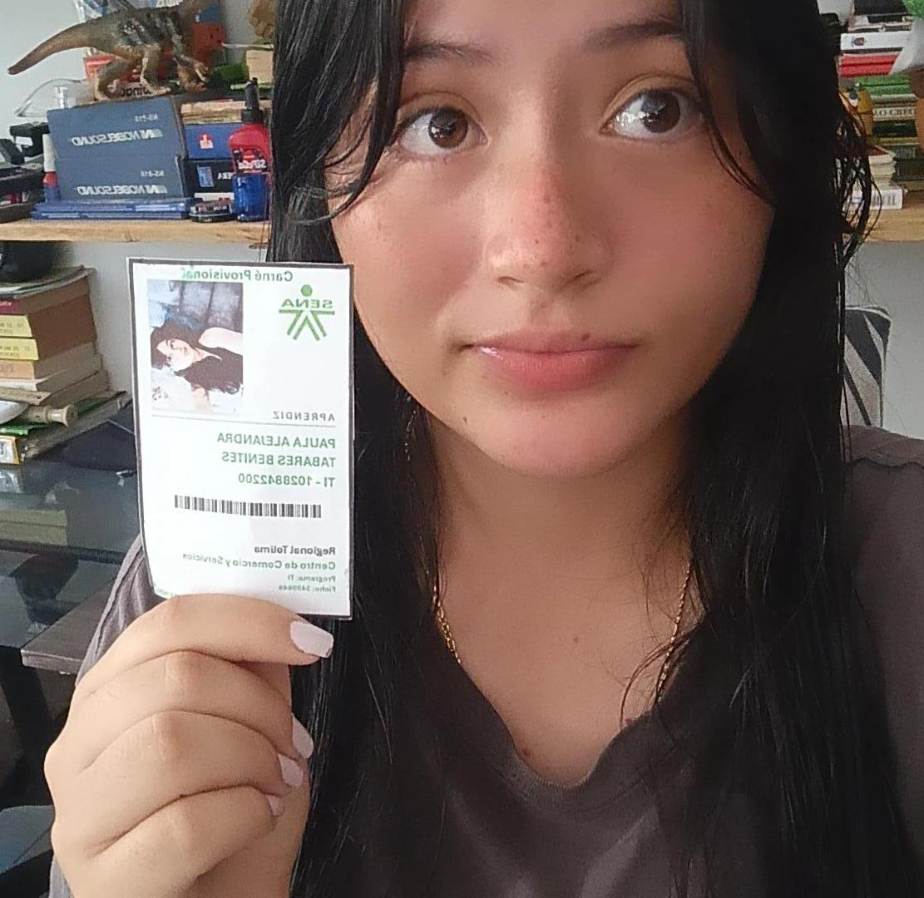
pic
This is Paula Tabares I am 16 and I am a 6 In English
I´m a SOFTWARE ANALYSIS AND DEVELOPMENT Technologist from SENA, 3409645.
HI
See you later

